Slide 1
WEB DEVELOPMENT PROJECT ON OH MY FOODIE!
SUBMITTED TO:
Preeti Shree Mam
&
Praveen Yadav Sir
PRESENTED BY:
RAJNISH KUMAR
183038
C.S.E./1 ^{ST} YEAR/ 2ND SEM
B. TECH

Slide 2
CONTENTS
INTRODUCTION OF WEBPAGE
INTRODUCTION OF WEBSITE
WHAT IS HTML?
WHAT IS CSS?
WHAT IS BOOTSTRAP?
WEBSITE – HOME PAGE
WEBSITE – ABOUT US
WEBSITE – CONTACT US
WEBSITE – LOGIN
WEBSITE- REGISTERATION
WEBSITE – MENU
WEBSITE – ORDER NOW
REFERENCES

Slide 3
INTRODUCTION OF WEBPAGE
WEBPAGE : A web page is a document that is suitable to act as a web resource on the World Wide Web.
When a webpage accessed by a web browser it may be displayed as a web page on a monitor or mobile device.
A web page is a smaller part of a larger website usually containing more specific information.

Slide 4
INTRODUCTION OF WEBSITE
WEBSITE :
A website or Web site is a collection of related network web resources, such as web pages, multimedia content, which are typically identified with a common domain name, and published on at least one web server.
A website is a collection of web pages with information on a subject.

Slide 5
WHAT IS HTML?
HTML :- HTML stands for HYPER TEXT MARKUP LANGUAGE.
HTML is the standard markup language for creating web pages.
• HTML describes the structure of pages using Markup
• HTML elements are the building blocks of HTML pages.
• HTML element are represented by tags.
• HTML tags label pieces of contain such as "heading", "paragraph", "table", and so on.
• Browsers do not display the HTML tags, but use them to render the content of the page

Slide 6
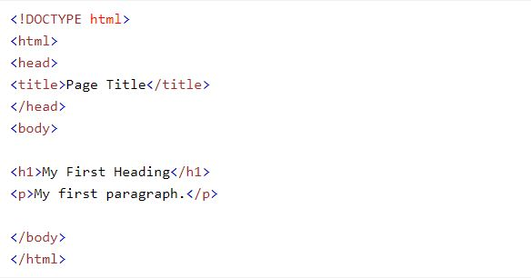
EXAMPLE OF A BASIC HTML PROGRAM

Slide 7
WHAT IS CSS?
CSS - CSS stands for Cascading Style Sheet
CSS is used to style the web pages
CSS describe how HTML elements are to be displayed in screen, paper, or in other media
CSS saves a lot of work. it can control the layout of multiple web pages all at once
External style sheets are stored in CSS files.

Slide 8
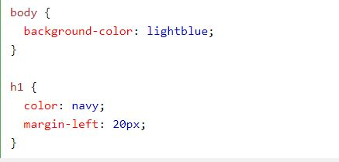
EXAMPLE OF CSS

Slide 9
WHAT IS BOOTSTRAP?
Bootstrap-Bootstrap is the most popular HTML, CSS, and JAVASCRIPT framework for developing responsive, mobile-first websites.
Feature of bootstrap- There are many feature of bootstrap some of them are:-
Easy to use
Responsive feature
Consistent design
Mobile first approach
Browser compatibility

Slide 10
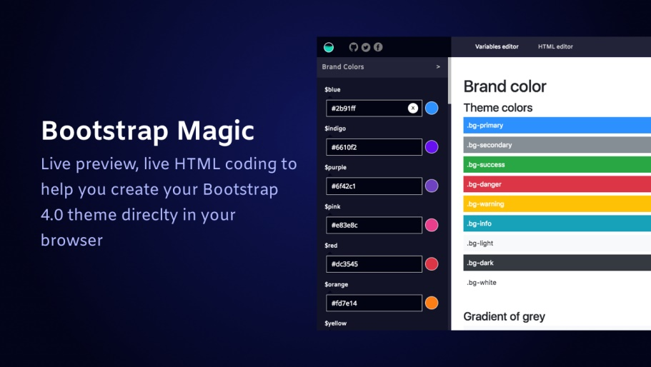
BOOTSTRAP

Slide 11
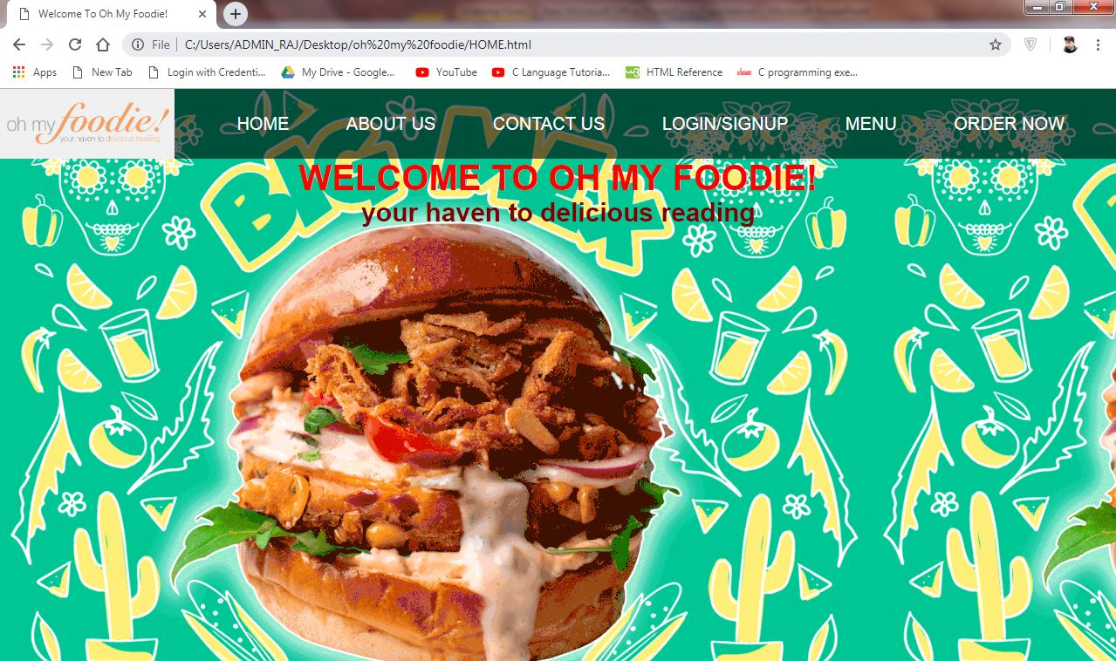
WEBSITE – HOME PAGE

Slide 12
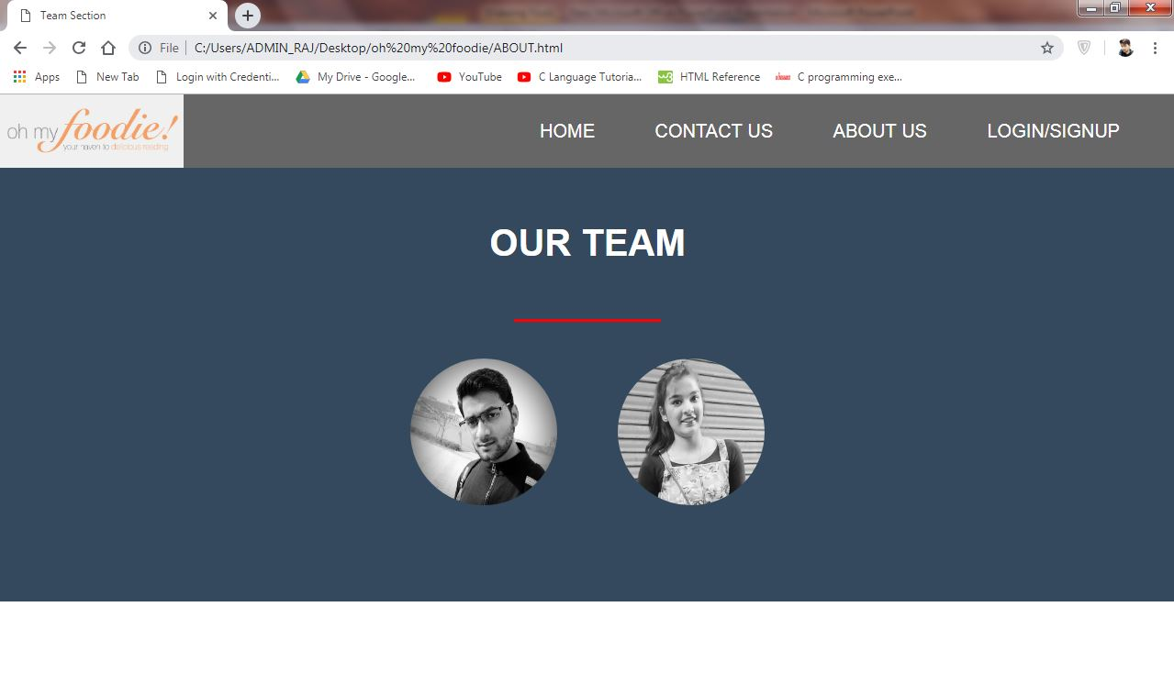
WEBSITE – ABOUT US

Slide 13
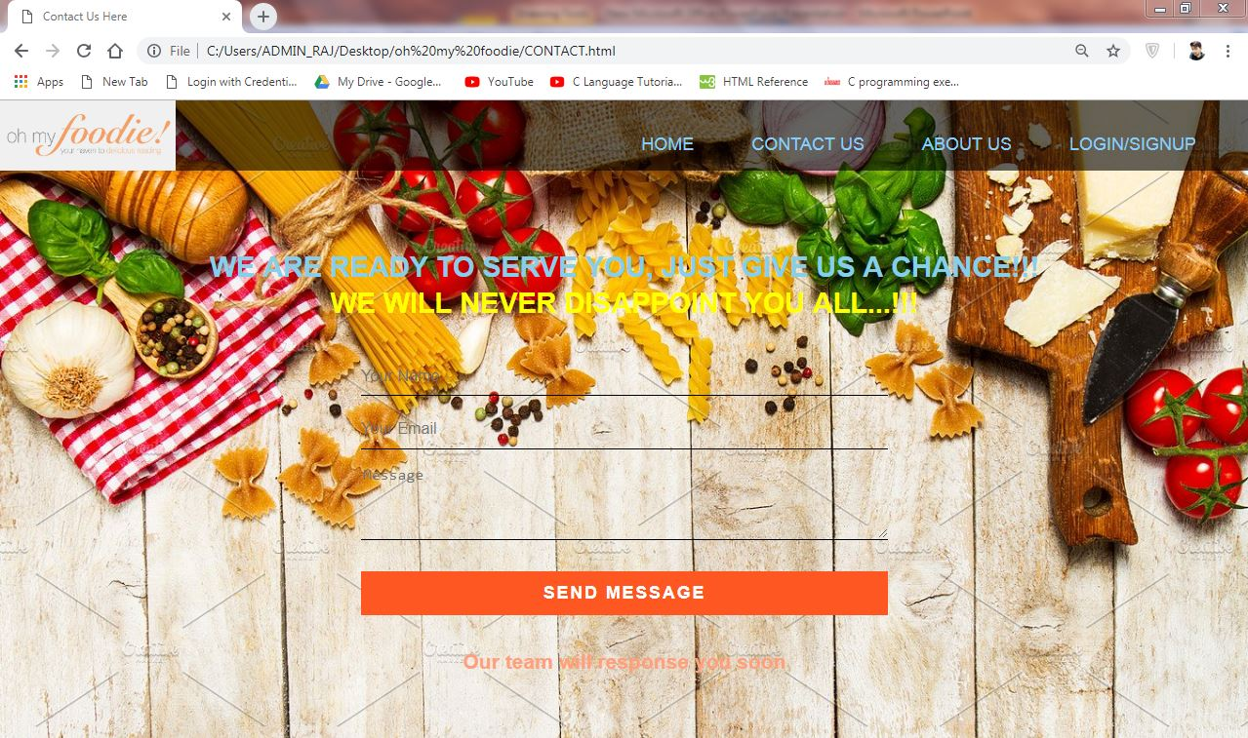
WEBSITE – CONTACT US

Slide 14
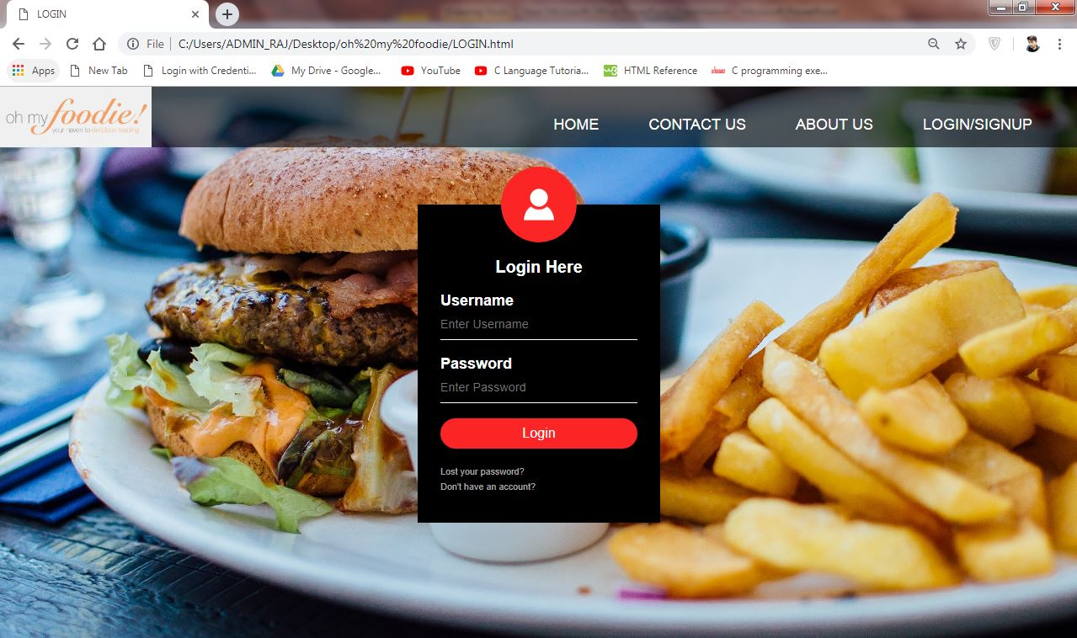
WEBSITE – LOGIN

Slide 15
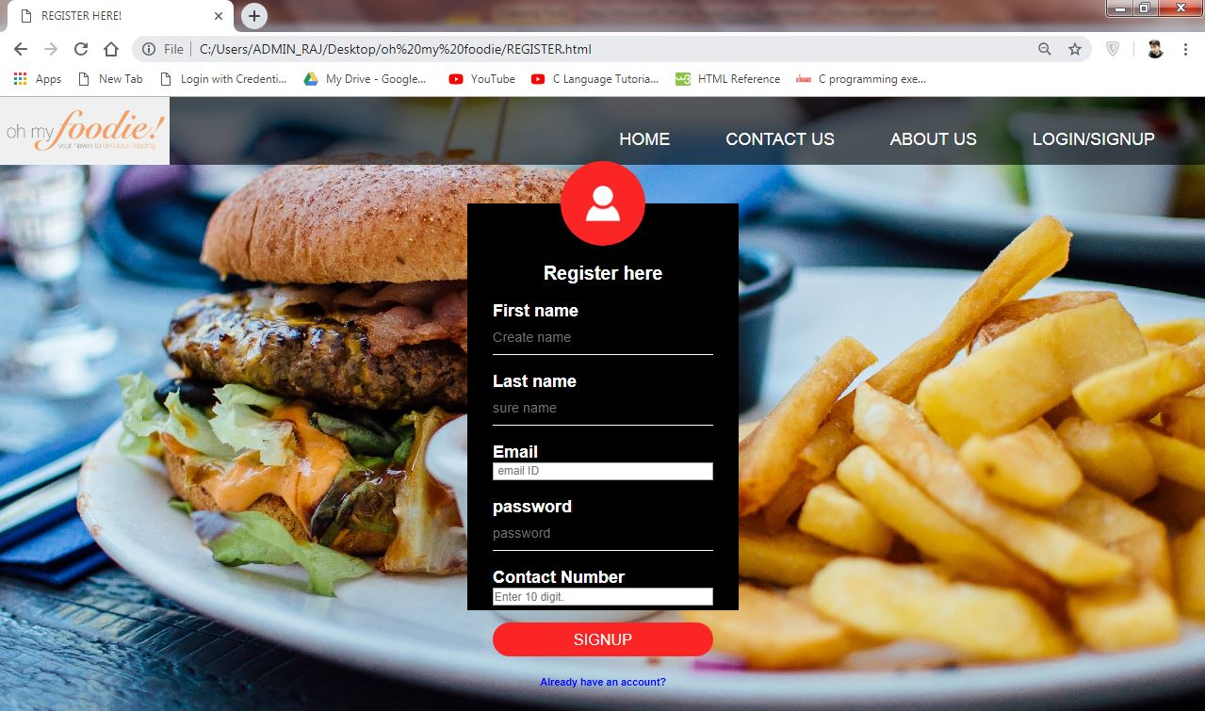
WEBSITE – REGISTERATION

Slide 16
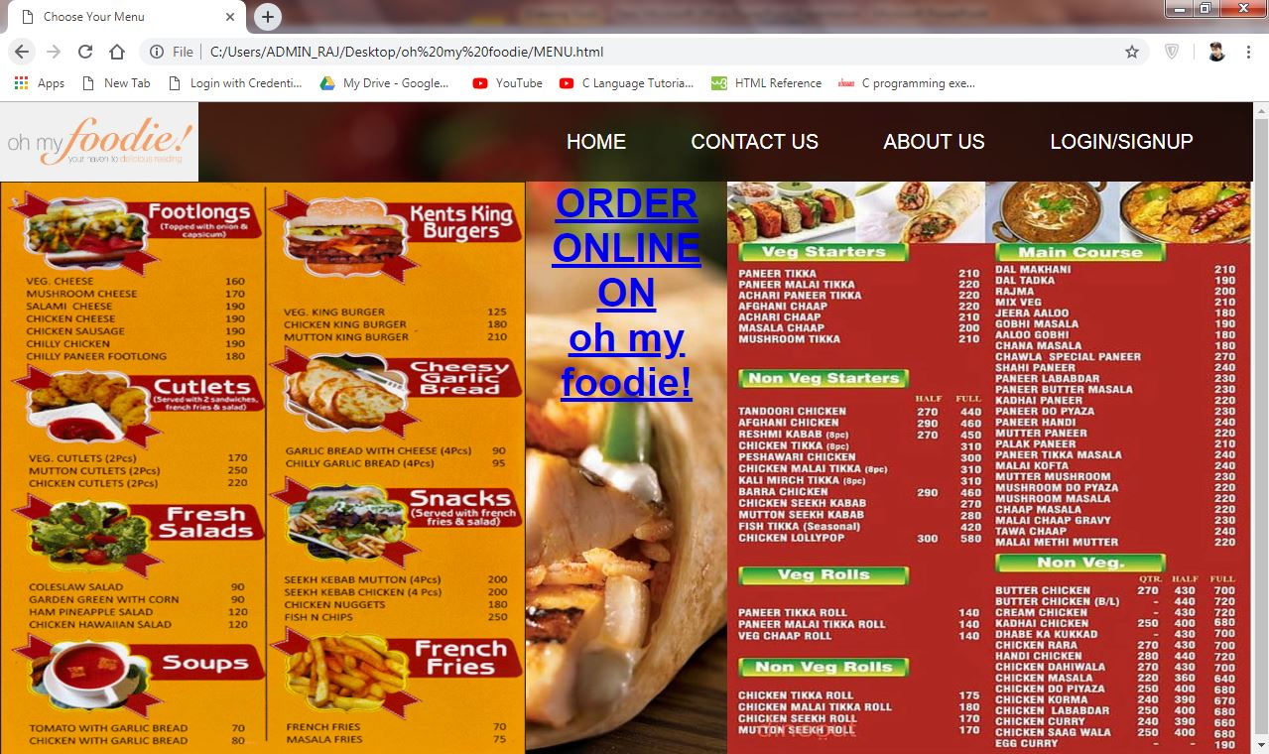
WEBSITE – MENU

Slide 17
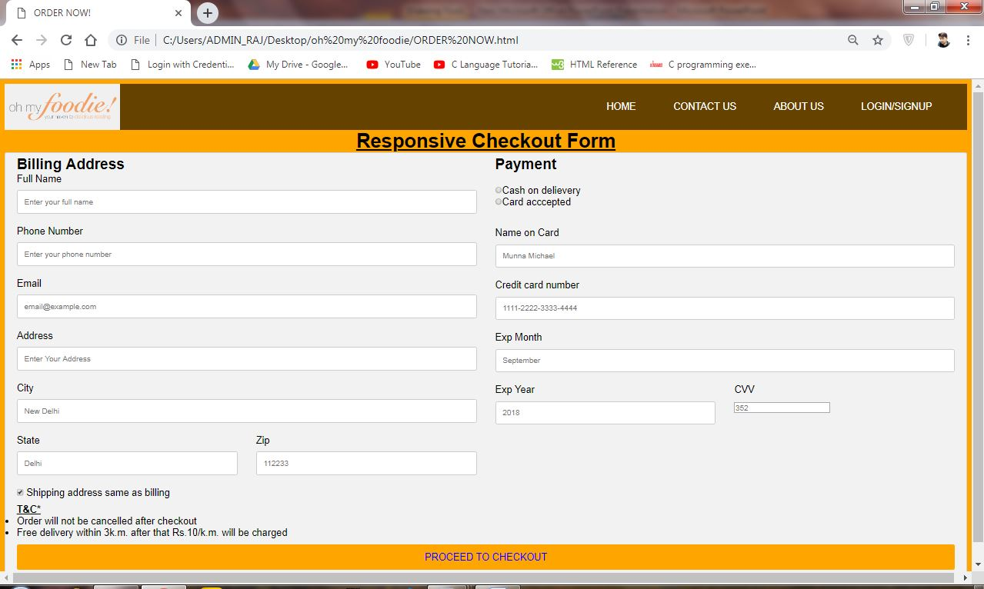
WEBSITE – ORDER NOW

Slide 18
REFERENCES
As per research and study , there are some references which is help in the completion of this project:
www.google.co.in
www.w3schools.com
www.getbootstrap.com
www.youtube.com

Slide 19
THANK YOU…!!!

